Slide 1
Distributed information system 3
Collaborative To Do List
–- Fantastic 4--
Koh Jin Cai Daemian
Lim Loon Haw WinWin
Soh Boon Keong
Sim Yee Keng

Slide 2
Goal & objectives
Assist a group in managing assignment(task).
keeping track of task at hand
Ensure that task is complete on time

Slide 3
system architecture diagram
client
MiddleWare
DataBase
user
Web browser
Django
Python-based SQLite3
Team Members
Team Leader
Notes:
client
web browser that renders html/css page
middle
•The middleware will be a Django application, and will be dispatched through Django’s built-in development web server while we develop.
database
•The database will be the Python-based SQLite3 Database engine.

Slide 4
ER diagram
User id
First name
Last name
Group Description
Group id
User id
Group
name
Member of
N
Group
UserProfile
M
M
1
Contain
Assign
N
Task
N
completed
Task id
Group id
User id
Task name
details
priority
Start end
End date

Slide 5
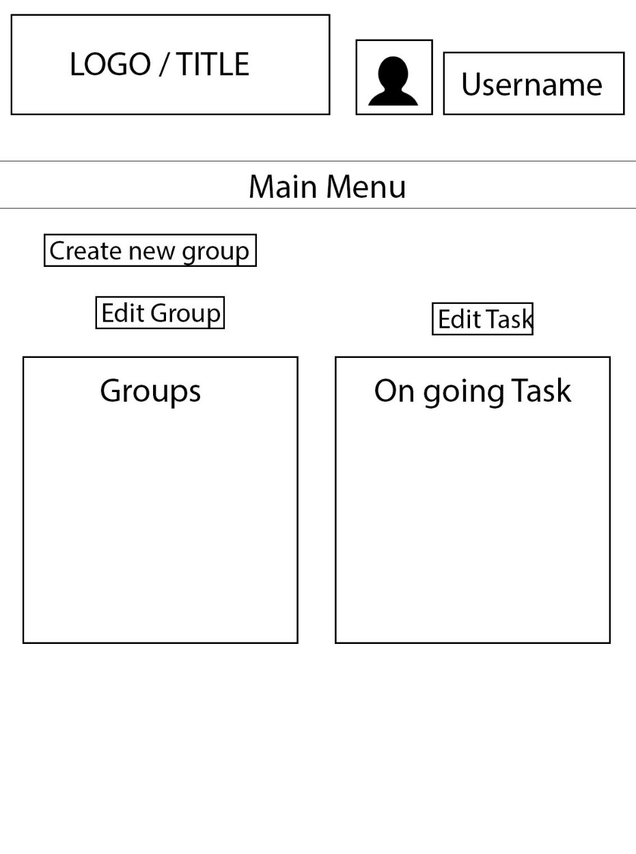
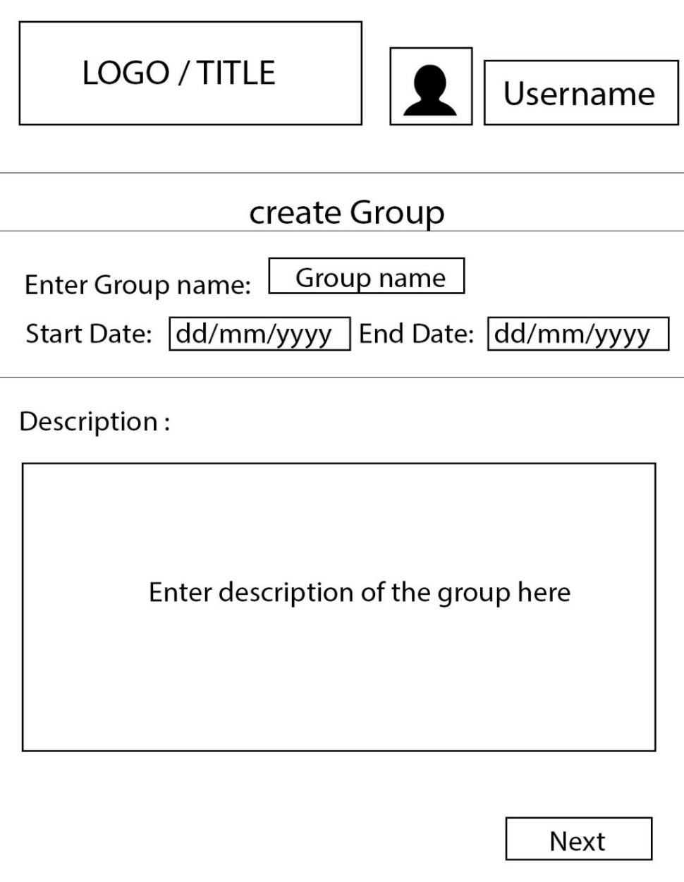
WireFrame

Slide 6
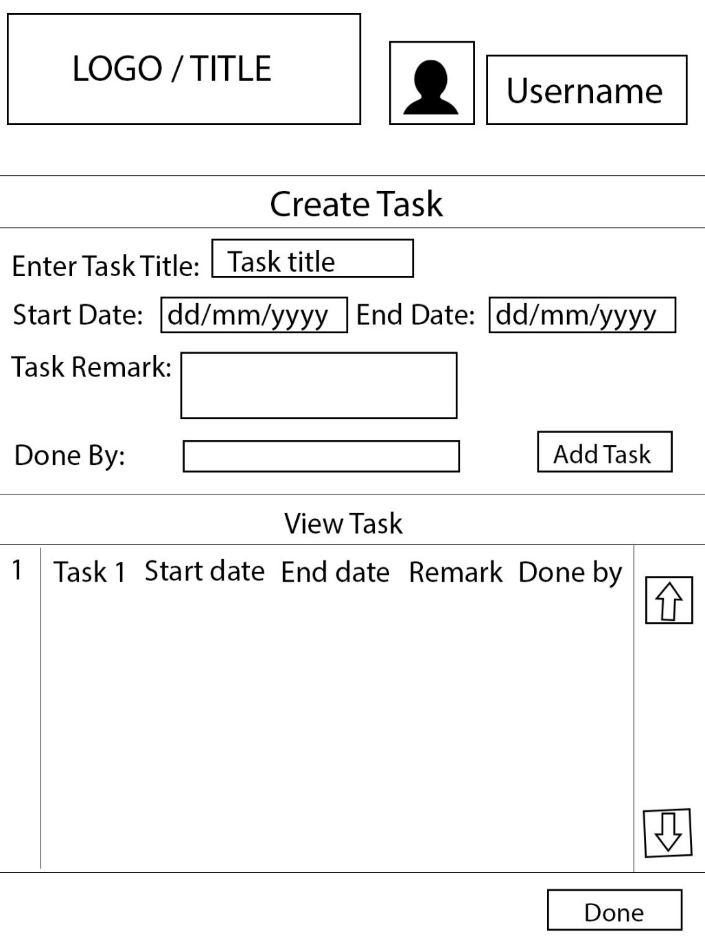
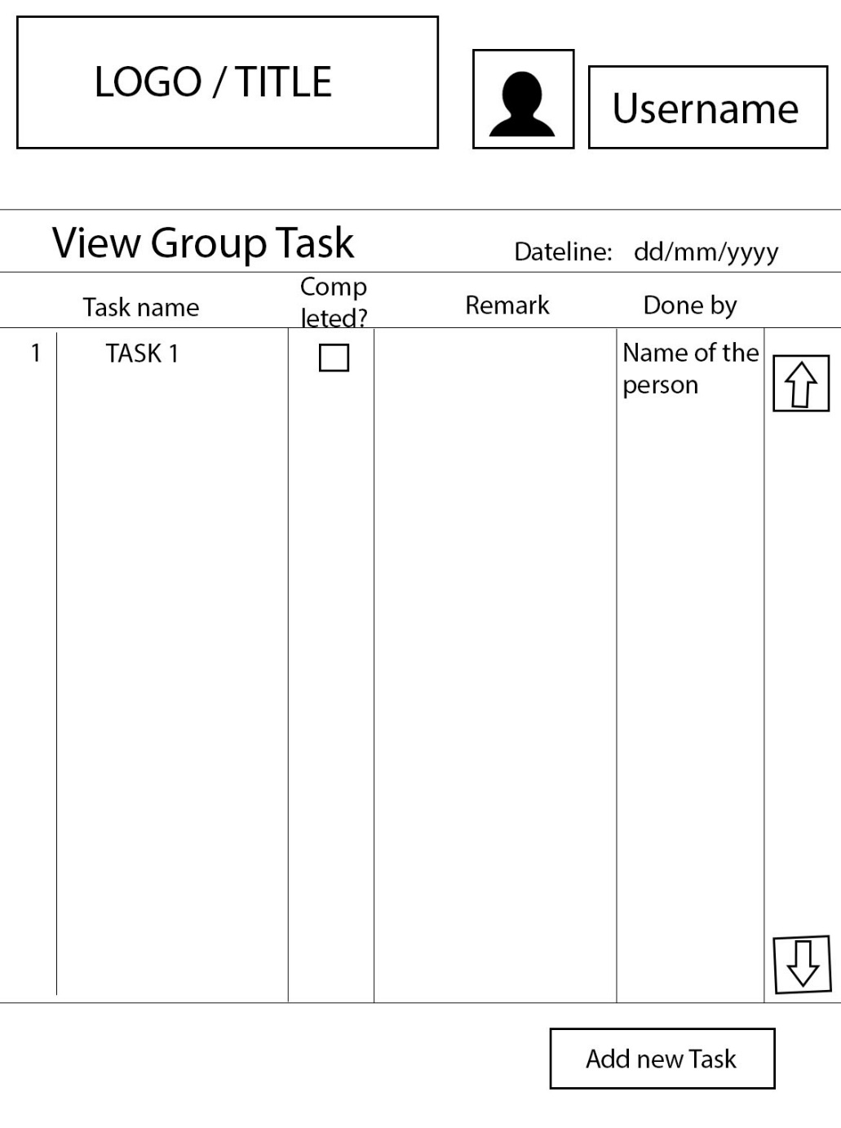

Slide 7
Stand out features/functionality
Able to set priority of task
History that review the task you have completed
Email reminders (Pending)
Excel Export
CSV Export

Slide 8
Functionality CHECKLIST
Completed
User able to view task as completed or incomplete
User able to modify task
User able to login
User able to assign task to other party
Other party should able to see their current task
User able to mark the task they have completed
Task are able to assigned with priorities (low, medium, high)

Slide 9
Functionality CHECKLIST
Incomplete
User able to create task
The user is able to assign the task to anyone from any group, instead of members of the same group
Not Done
Subtask
Email reminders
Excel Export
CSV Export
Alert when the to do list is near the deadline

Slide 10
FAQ

Slide 11
Specification List
Must have
User able to create a list of task
User able to view a list of task
User able to modify the task
Should have
User able to login
User able to assign task to other member
User able to mark the task they have to be completed

Slide 12
Specification List
Could have
Other party could able to create a sub task of their own to manage
Other party could able to edit their sub task list
Task prioritisation
Email reminders
Excel Export
CSV Export
Alert when the to do list is near the deadline

Slide 13
PERSONA 1
Johnny Toh
Team Leader
General Description
Project leader of a development team for web based application projects. He is to ensure that clients requirements are met, and also the product is delivered on time.
He have the responsibility of how the application is developed, and the integration of the project.
Key Functions
ensure specifications met
choice of project development platform
project integration
project delivered timely
Critical Needs
able to manage group members
keep track of task completion
knowing who is assigned the task
complete task according to its priority
Opportunities to improve user experience
allow task completion to be updated real time
sorting of task according to priority

Slide 14
PERSONA 2
Alexander Lim
Team Member
General Description
Project member of a development team for web based application projects. He is to ensure that the application is build as specified.
He have the responsibility of the functions of the system, and ensuring that the system is build as it is designed.
Key Functions
development of project
ensure that system components developed are working
Critical Needs
task stating order to be completed in
knowing his responsibility in the project
able to update the leader of his progress
Opportunities to improve user experience
able to list out steps required to complete task
allow task completion to be updated real time
sorting of task according to priority

Slide 15
USER NEEDS MATRIX
 |  | Overall Priority | Leader | Member
MANAGE GROUP | Able to create group | 5 | 5 | -
 | Able to disband group | 4 | 4 | -
 | Able to add member | 5 | 5 | -
 | Able to remove member | 4 | 4 | -
CREATE TASK | Able to create task | 5 | 5 | 5
 | Able to assign task to self | 3 | 3 | 3
 | Able to assign task to others | 1 | 3 | -
DELETE TASK | Remove any task | 1 | 3 | -
 | Remove task I am responsible of | 2 | 1 | 3
AMEND TASK | Make changes to the task | 1 | 2 | -
 | Mark completion of task | 2 | 1 | 3
VIEW TASK | View all task of the project | 3 | 3 | 2
 | View the progress of the task | 2 | 3 | 1
 | View the task according to it priorities | 4 | 4 | 3
 | View all task I am responsible of completing | 3 | 3 | 4

Slide 16
SITE Map
FAQ
User details
User details
Support Ticket
Forum
Register
Login
Contact Us
HOME
Add Task
Manage Group
Update Task
Set Completed
Add Task
Manage Users
Delete Task
Update Task
Delete Task
Add Users
Delete User
Edit Permission
Assign Task
Set Completed

Slide 17
URLs
www.collaborativetodolist.com/index
www.collaborativetodolist.com/contactus
www.collaborativetodolist.com/register
www.collaborativetodolist.com/login
www.collaborativetodolist.com/creategroup
www.collaborativetodolist.com/addtask

